Slide 1
LM-10/20/21/30 Updates
Fixing the display of the Amended special reports in OPDR
New features
Pre-populate data option (New Reports)

Slide 2
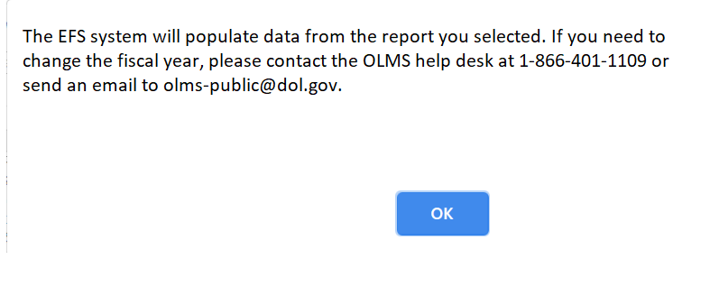
Amending LM-10/20/21/30 Reports
The system will display the following message when selecting an LM-10, LM-2, LM-21 and LM-30 report from the list.

Slide 3
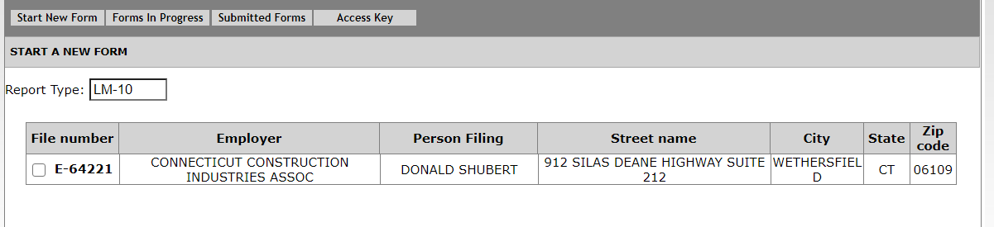
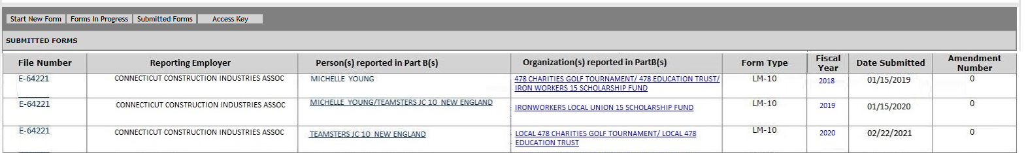
Amending LM-10 Reports
All submitted reports will be listed under the Submitted Forms tab.
LM-10 Submitted Forms page
Submitted Forms page for the LM-10 Report Type will list the following fields. The filer will select a report from the list to submit an amendment report.

Slide 4
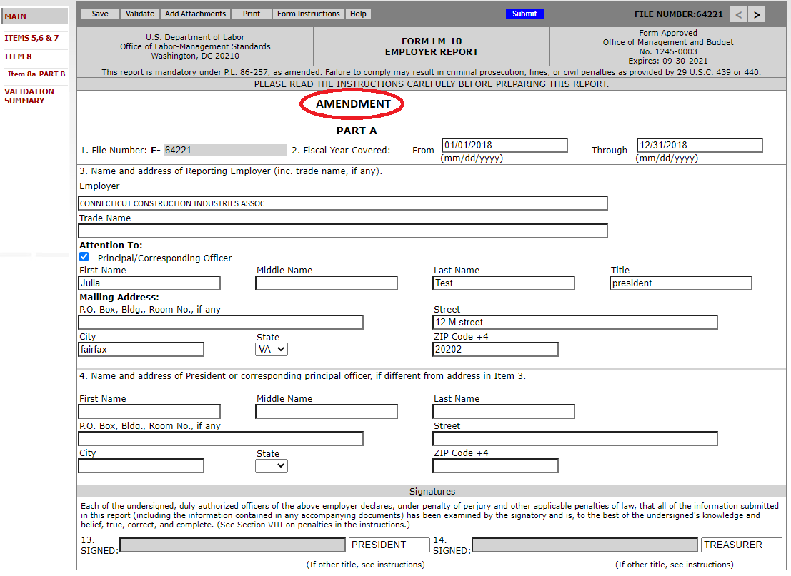
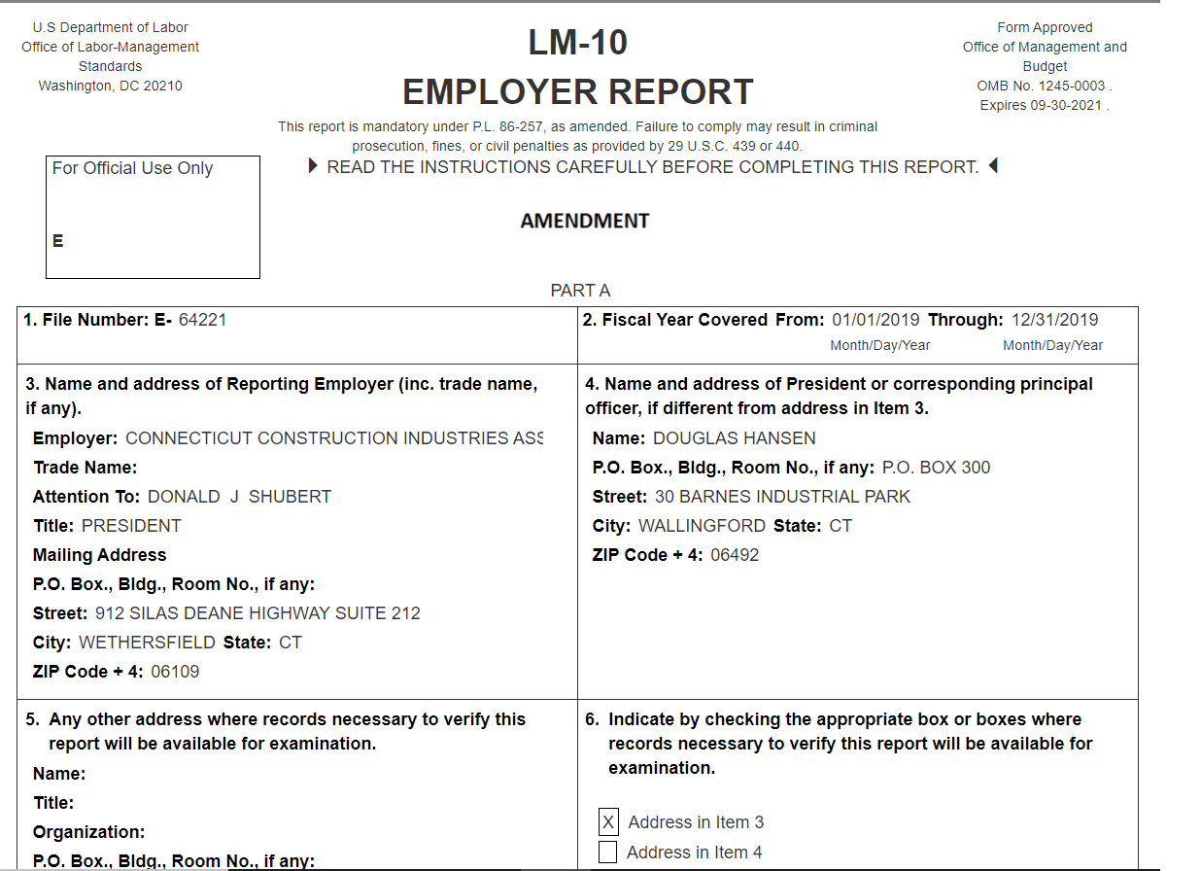
Amending LM-10 Report
The system will populate the data on the form
The system will display the text AMENDMENT on the top section on the first page.
The Employer field will be populated and enabled for editing. If the company changed the name during the year, the filer should be able to update it.
File Number, Fiscal Year Period and Employer fields will be disabled when submitting an amendment.
First Page
Disclosed Report

Slide 5
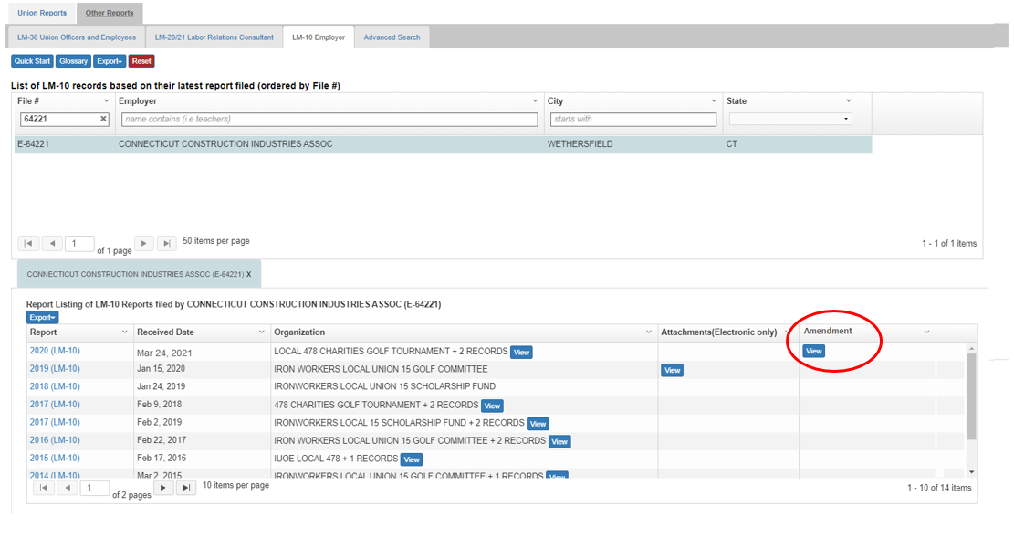
Amended Reports – OPDR LM-10 View
OPDR will display the data from the latest amended report and will have a View button to view all reports submitted in that Fiscal year:

Slide 6
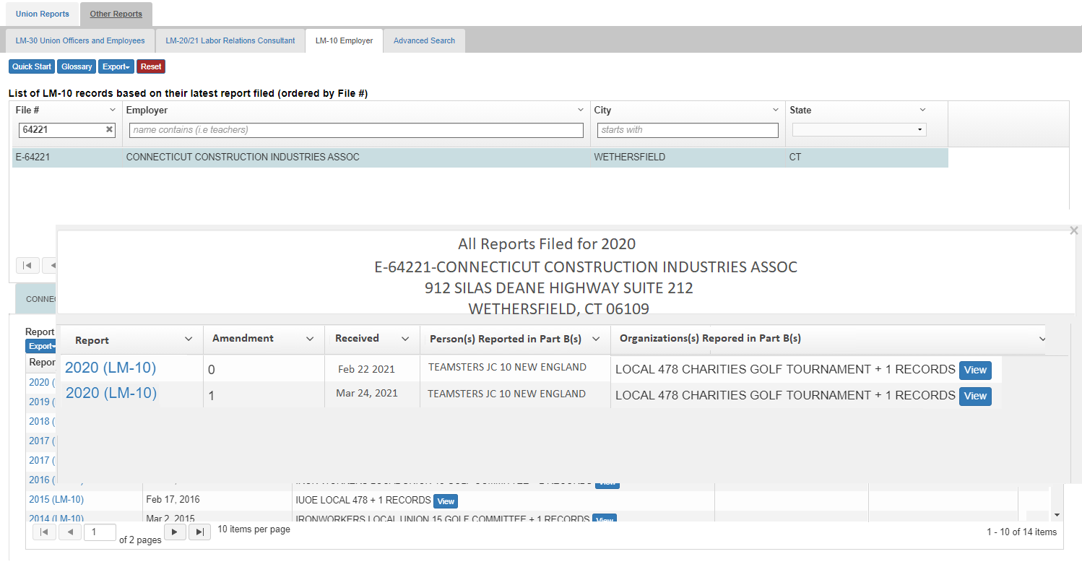
Amended LM-10 Reports – OPDR View
Clicking the View button, a pop-up window will listing all reports for that unique instance of report during the fiscal year. For example, if LRI has 100 reports in a year, the grid will show all unique LM-10s and view will show the different amendments for each unique instance :

Slide 7
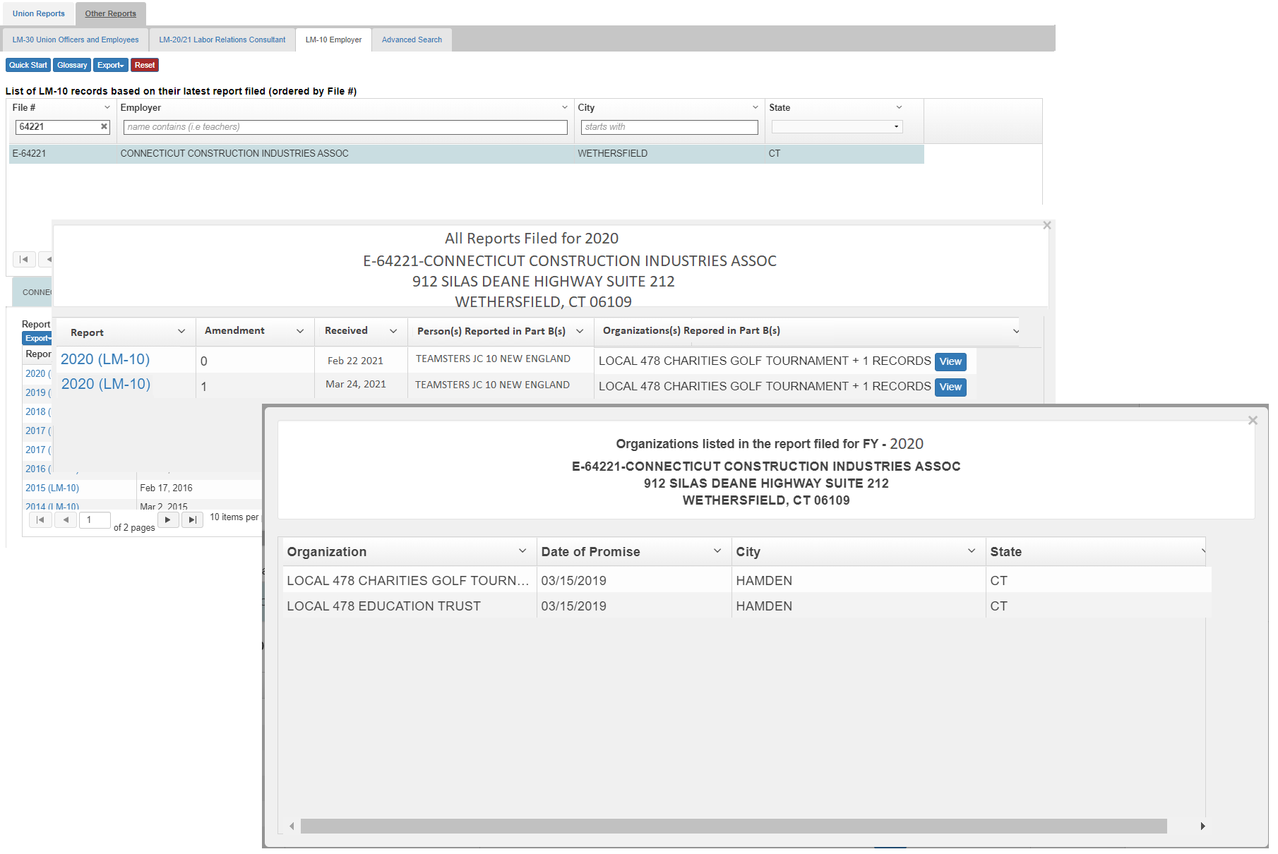
Amended Reports – OPDR View
If the report has multiple part Bs submitted, the first employer and the count will be listed in this pop-up. Clicking the View button will give the complete list employers.

Slide 8
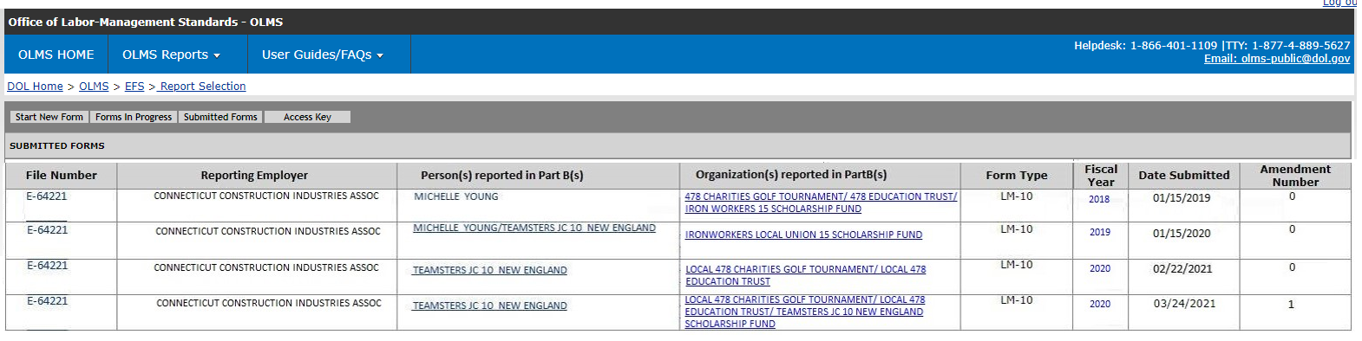
Amending LM-10 Reports
Once the report is submitted, the amendment number will be incremented by one.
The Submitted Forms page (view within the EFS):

Slide 9
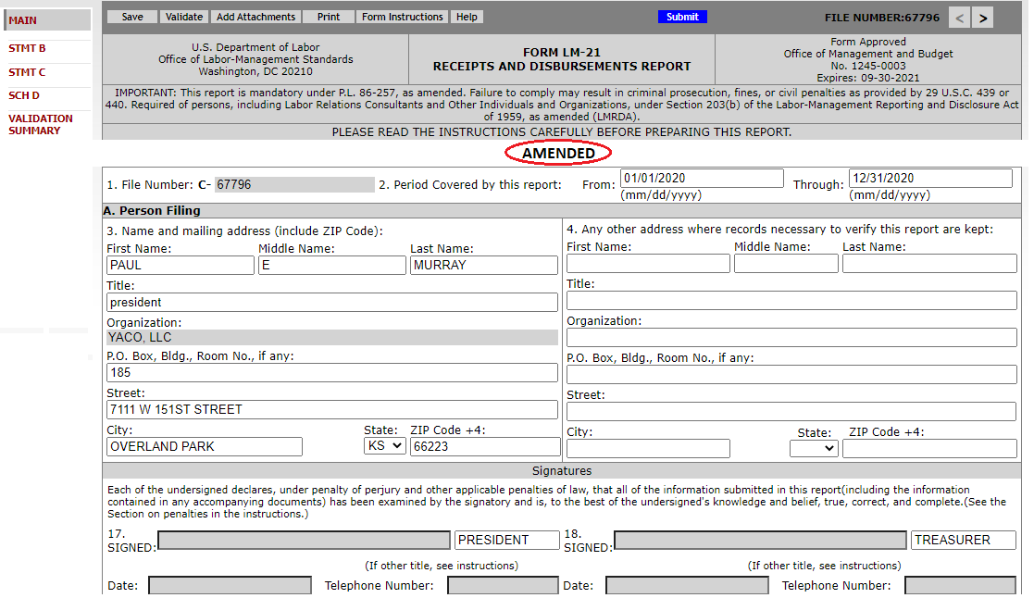
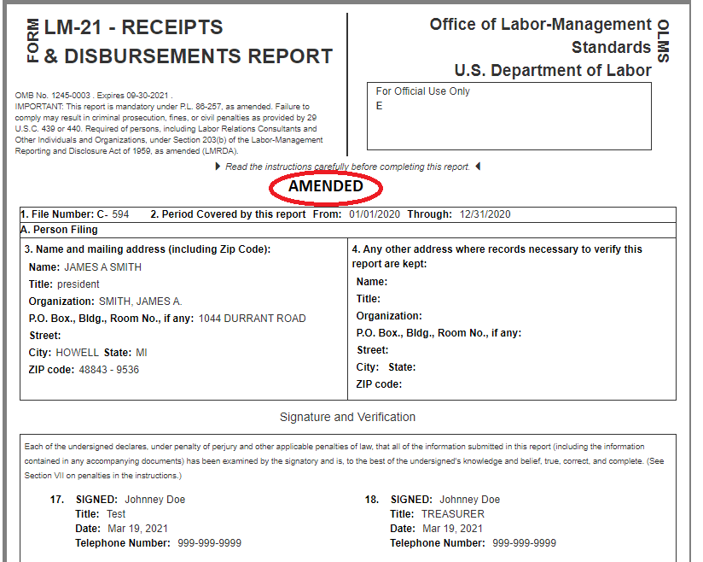
Amending LM-21 Report
The system will populate the data on the form
The system will display the text AMENDMENT on the top section on the first page.
The File Number, Fiscal Year Period and Organization fields will be disabled when submitting an amendment.
First Page
Disclosed Report

Slide 10
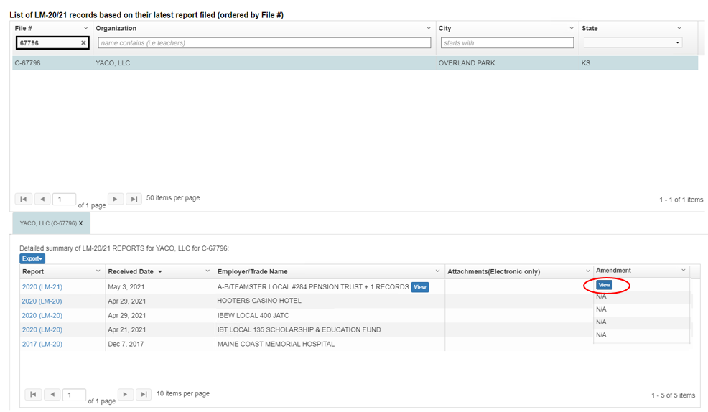
Amended Reports – OPDR LM-21 View
OPDR will display the data from the latest amended report and will have a View button to view all reports submitted in that Fiscal year:

Slide 11
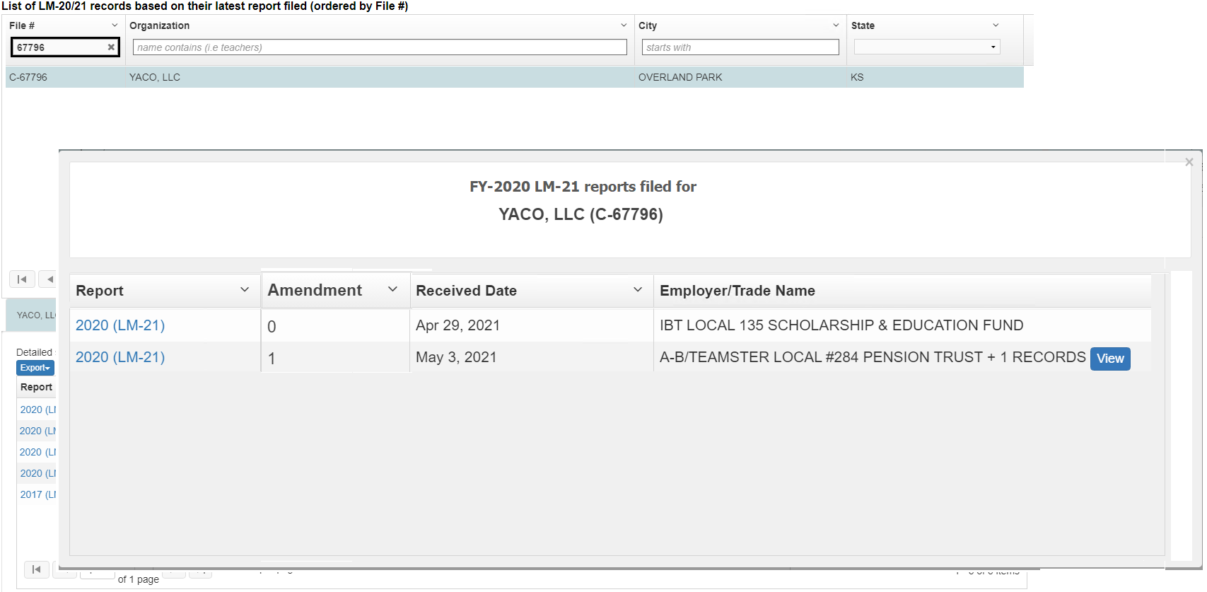
Amended LM-21 Reports – OPDR View
Clicking the View button, a pop-up window will open listing all reports submitted in a Fiscal year:

Slide 12
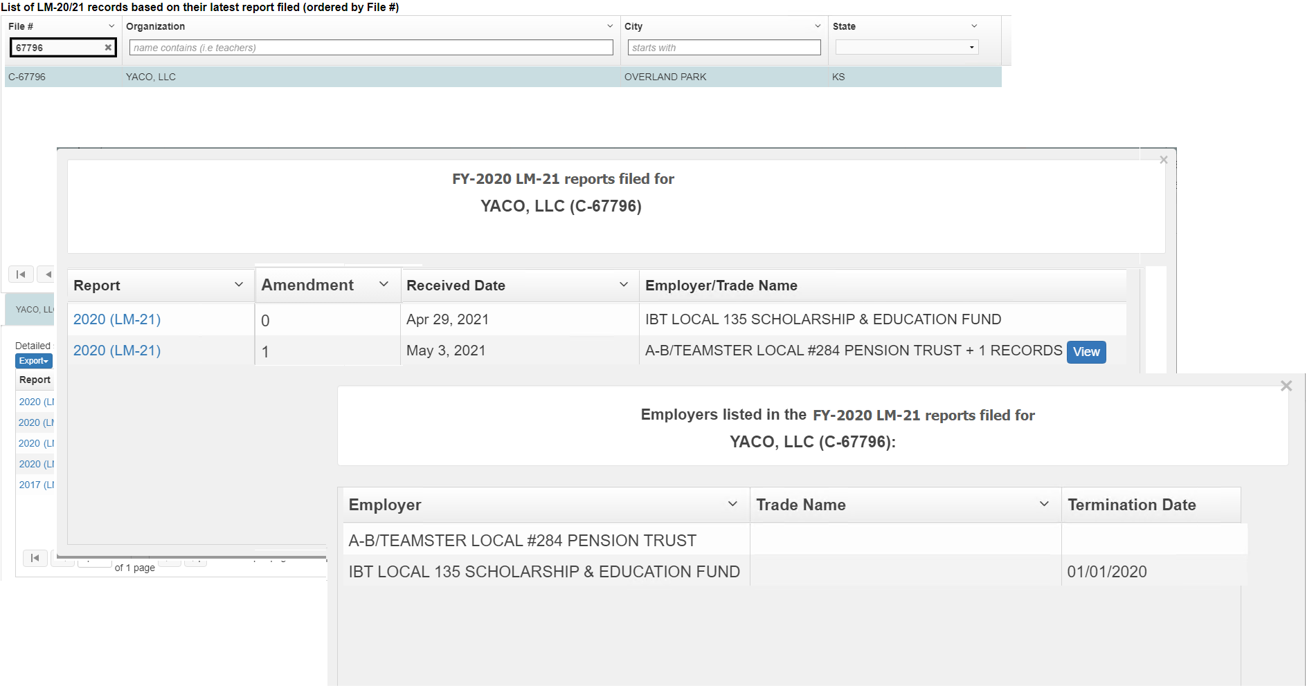
Amended Reports – OPDR View
If the report has multiple employers listed, the first employer and the count will be listed in this pop-up. Clicking the View button will give the complete list employers.

Slide 13
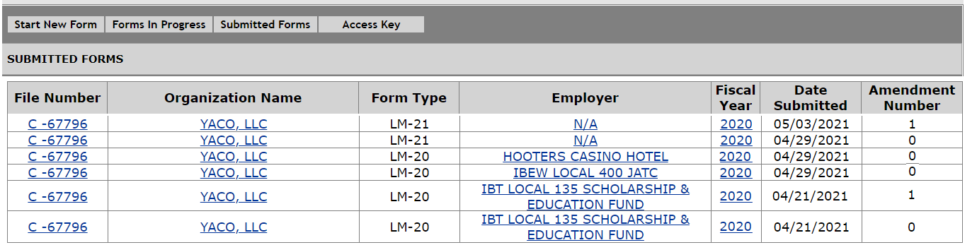
Amending LM-21 Reports
Once the report is submitted, the amendment number will be incremented by one.
The Submitted Forms page (view within the EFS):

Slide 14
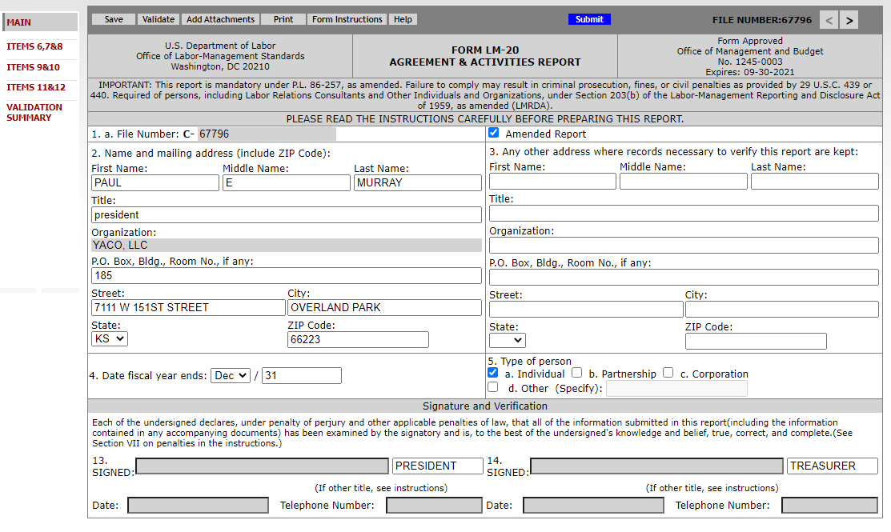
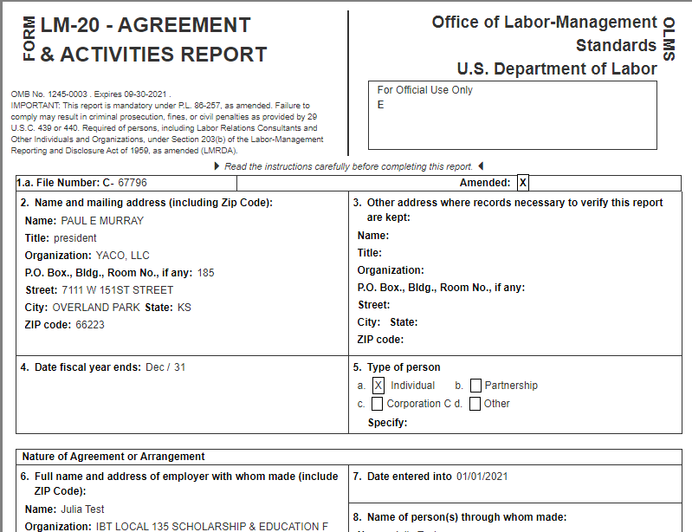
Amending LM-20 Report
The system will populate the data on the form
The File Number and Organization fields will be disabled when submitting an amendment.
The report has the Amended Report check-box automatically checked.
First Page
Disclosed Report

Slide 15
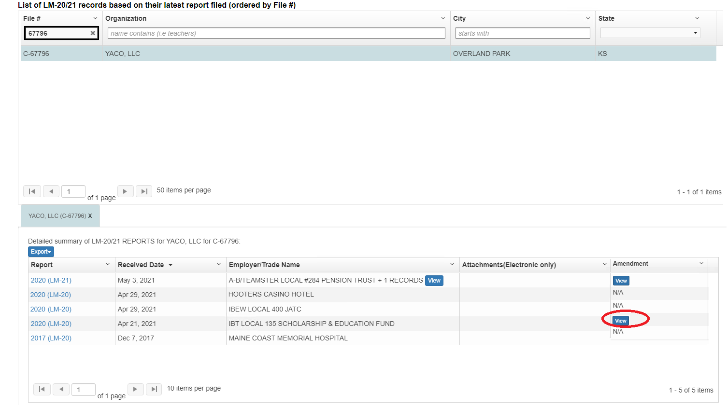
Amended Reports – OPDR LM-20 View
Clicking the View button, a pop-up window will listing all reports for that unique instance of report during the fiscal year.

Slide 16
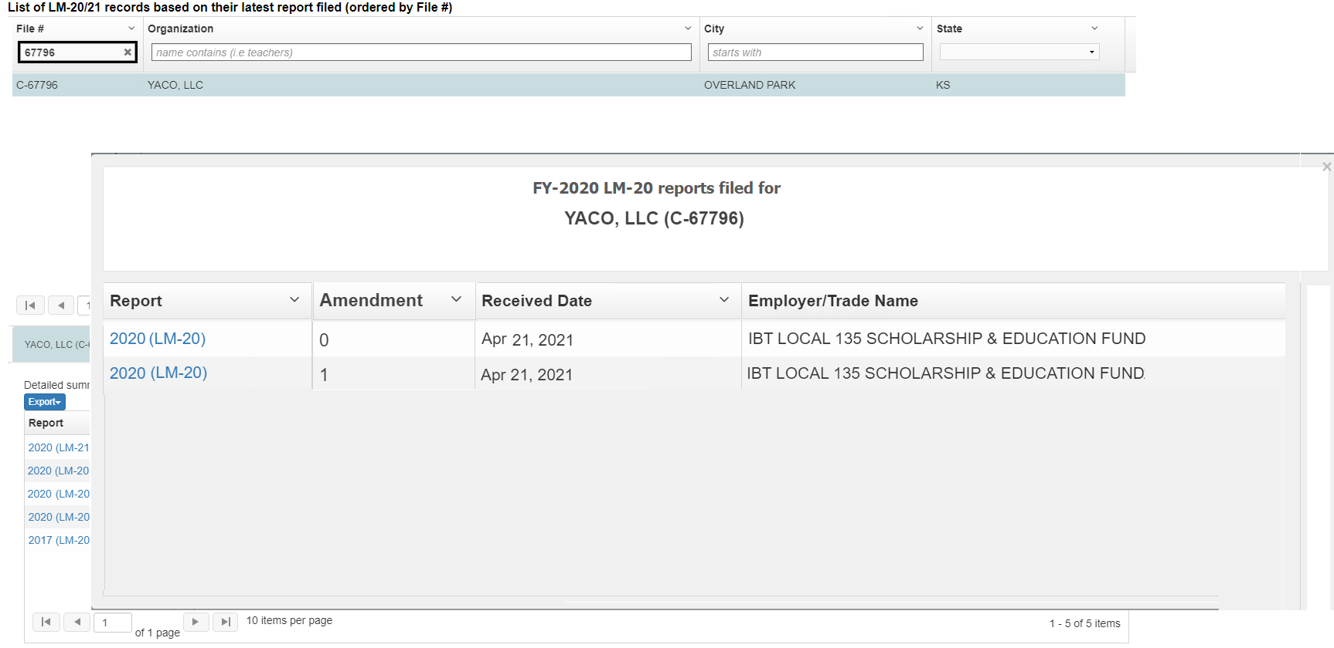
Amended Reports – OPDR LM-20 View
Clicking the View button, a pop-up window will open listing all reports submitted in a Fiscal year:

Slide 17
Amending LM-20 Reports
Once the report is submitted, the amendment number will be incremented by one.
The Submitted Forms page (view within the EFS):

Slide 18
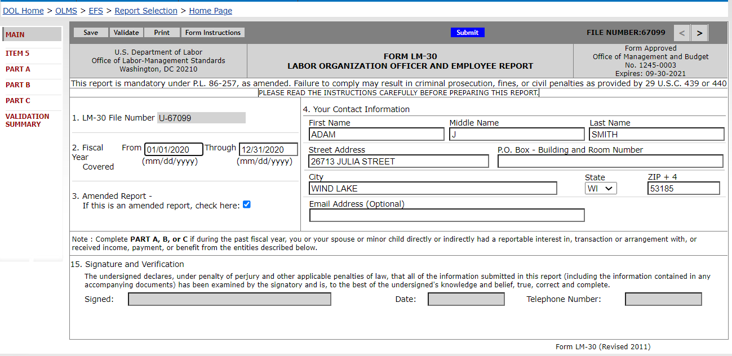
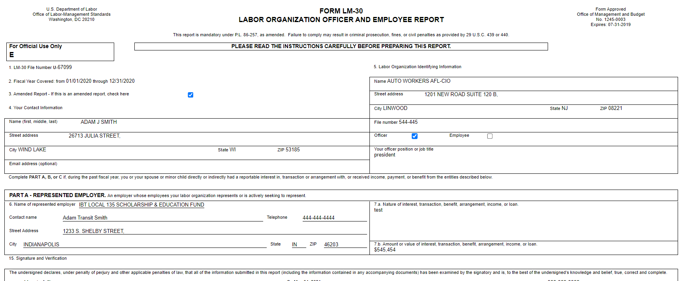
Amending LM-30 Report
The system will populate the data on the form
The File Number and Organization fields will be disabled when submitting an amendment.
The report has the Amended Report check-box automatically checked.
First Page
Disclosed Report

Slide 19
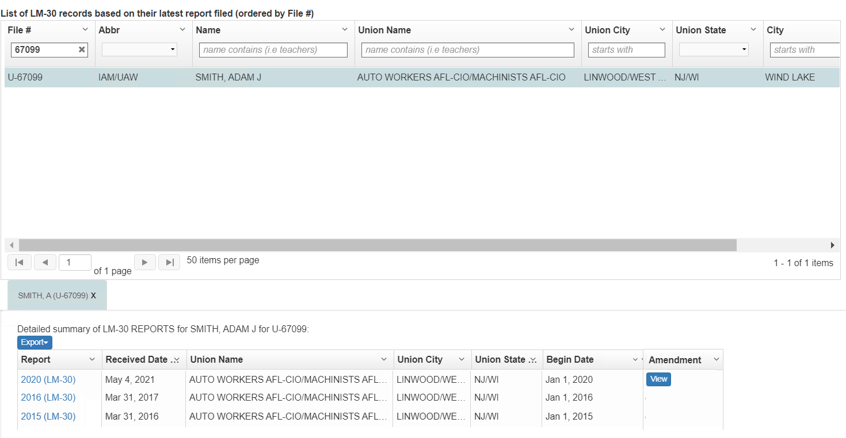
Amended Reports – OPDR LM-30 View
OPDR will display the data from the latest amended report and will have a View button to view all reports submitted in that Fiscal year:

Slide 20
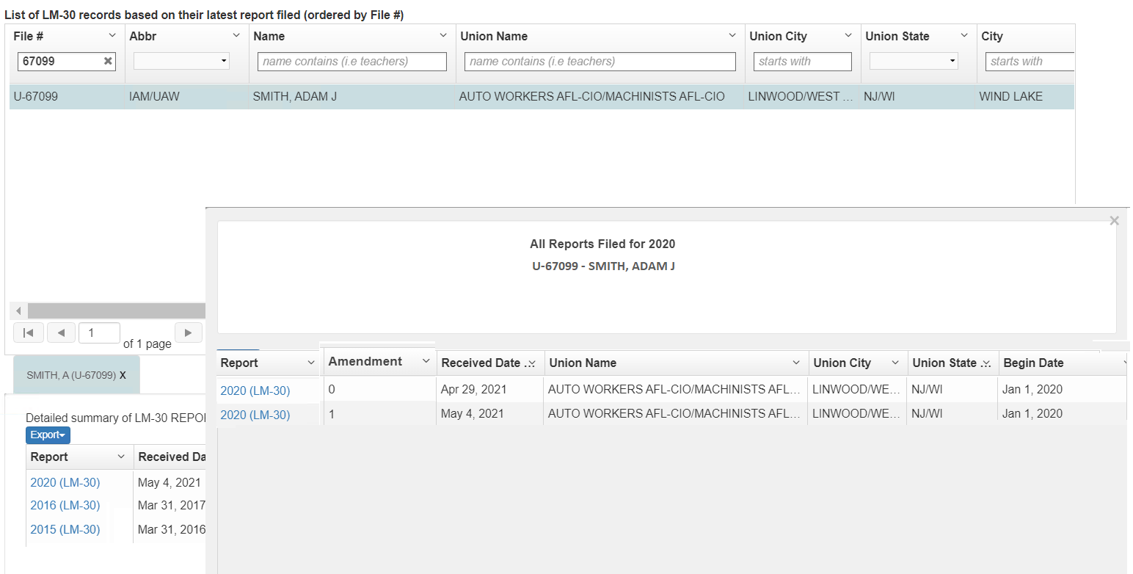
Amended LM-30 Reports – OPDR View
Clicking the View button, a pop-up window will open listing all reports submitted in a Fiscal year:

Slide 21
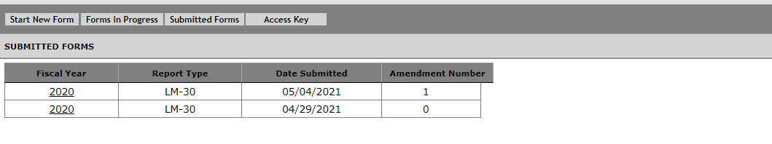
Amending LM-30 Reports
Once the report is submitted, the amendment number will be incremented by one.
The Submitted Forms page (view within the EFS):

Slide 22
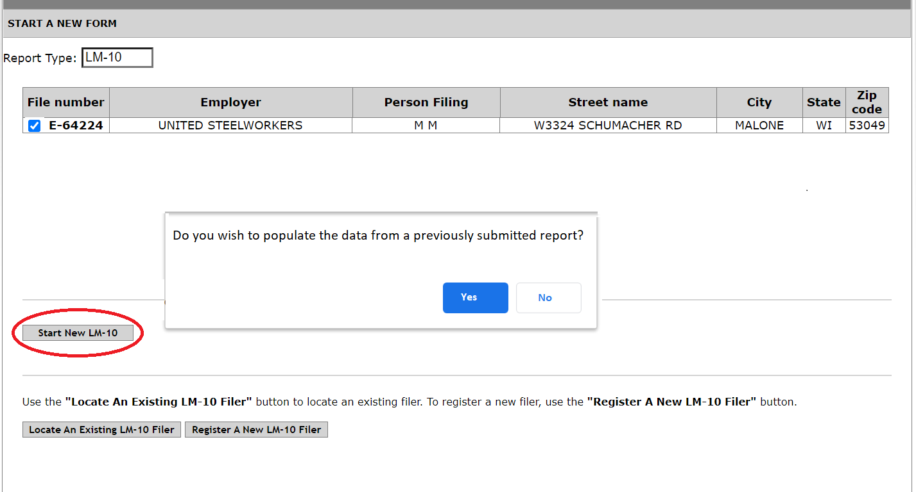
Pre-Populate Data From a Submitted LM-10 Report
When the filers return to submit a new special report and clicks the Start New button
The system will ask if the filer wants to pre-populate the data from a submitted report.
If the filer selects No the system will open a blank new form.
If the filer selects Yes, the system will list the submitted reports in the following format:
The filer will pick a report from the list.
The system will populate the data from the selected report on the form

Slide 23
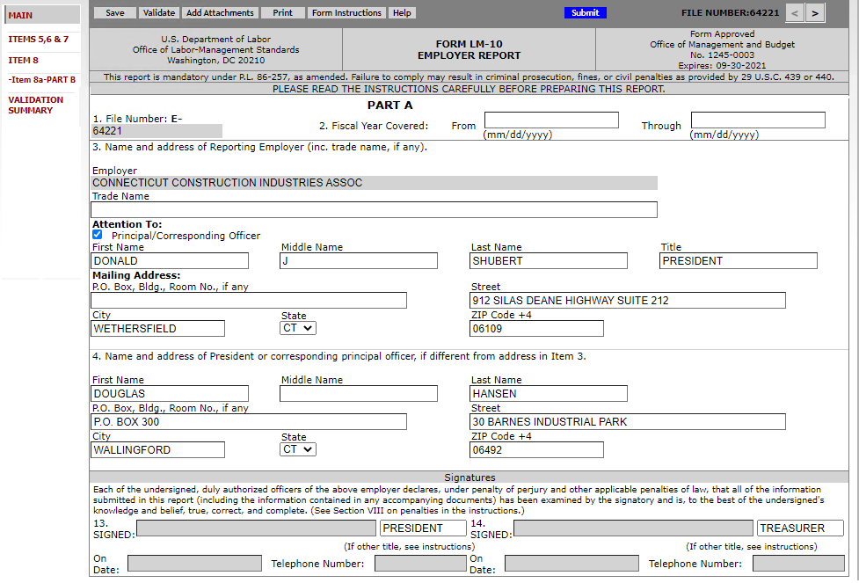
Pre-Populate Data From a Submitted LM-10 Report
The data from the selected report, except Fiscal Year Covered, will be pre-populated on the form.
Fiscal Year Covered will be blank. The filer will have to enter the date.
The filer can modify everything except the File Number and the Employer.

Slide 24
Pre-Populate Data From a Submitted LM-10 Report
During the validation, the system will check if there is an already submitted report for the same fiscal year.
The system will use the following fields to find the duplicate report:
Will check the Fiscal Year, Item 8 (same item 8 selected), the last name entered in Part B.9b, and the organization entered in item 9.d are the same when comparing with the submitted report.
If a duplicate report found, the following validation message will be displayed:
It appears that the data entered in this report has already been submitted. Are you submitting an amendment to the report submitted? With and Yes and No buttons
If the filer selects “Yes,” the system will convert the form in progress as an Amendment to the submitted report.
Selecting “No,” the system will consider the report as another one in the same fiscal year.
Amendment # 0 will be assigned for this report.

Slide 25
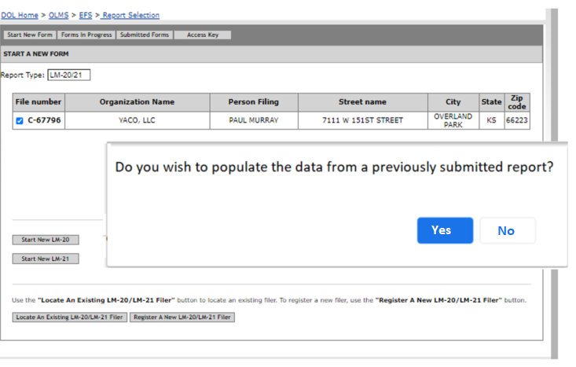
Pre-Populate Data From a Submitted LM-21 Report
When the filers return to submit a new special report and clicks the Start New button
The system will ask if the filer wants to pre-populate the data from a submitted report.

Slide 26
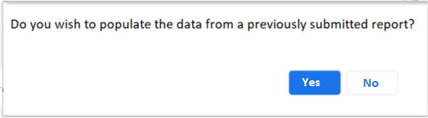
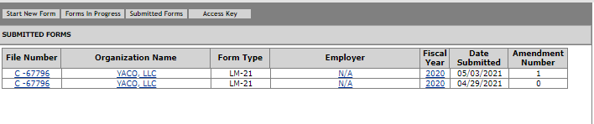
Pre-Populate Data From a Submitted LM-21 Report
If the filer selects No the system will open a blank new form.
If the filer selects Yes, the system will list the submitted LM-21 reports in the following format:
The filer will pick a report from the list.
The system will populate the data from the selected report on the form

Slide 27
Pre-Populate Data From a Submitted LM-21 Report
During the validation, the system will check if there is an already submitted report for the same fiscal year.
The system will use the following fields to find the duplicate report:
Will check the Fiscal Year, Item 2.
If a duplicate report found, the following validation message will be displayed:
It appears that the Fiscal Year entered in this report has already been submitted. Are you submitting an amendment to the report submitted? With and Yes and No buttons
If the filer selects “Yes,” the system will convert the form in progress as an Amendment to the submitted report.
Selecting “No,” the system will consider the report as another one in the same fiscal year.
Amendment # 0 will be assigned for this report.

Slide 28
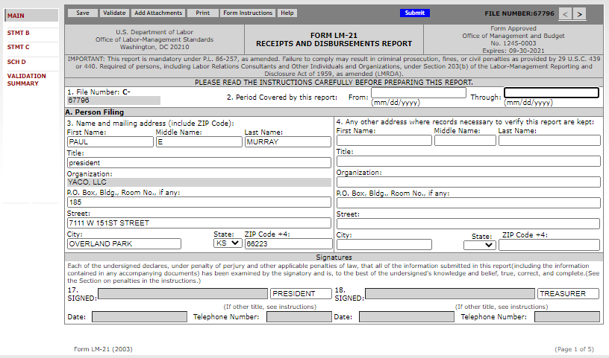
Returning LM-20 Filers Pre-populate data on the report
The data from the selected report, except Fiscal Year Covered, will be pre-populated on the form.
Fiscal Year Covered will be blank. The filer will have to enter the date.
The filer can modify everything except the File Number.

Slide 29
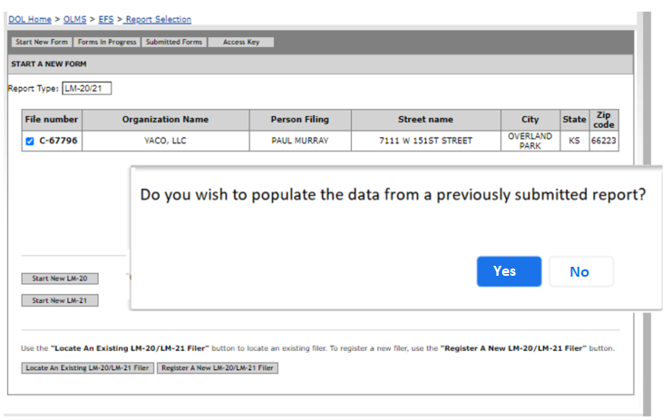
Pre-Populate Data From a Submitted LM-20 Report
When the filers return to submit a new special report and clicks the Start New button
The system will ask if the filer wants to pre-populate the data from a submitted report.

Slide 30
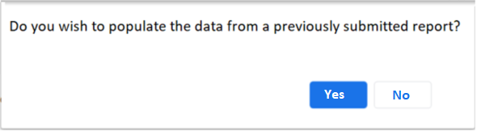
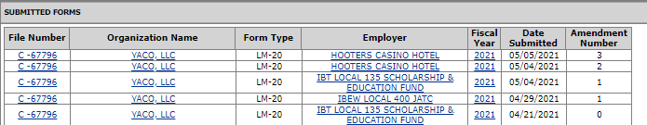
Pre-Populate Data From a Submitted LM-20 Report
If the filer selects No the system will open a blank new form.
If the filer selects Yes, the system will list the submitted LM-20 reports in the following format:
The filer will pick a report from the list.
The system will populate the data from the selected report on the form

Slide 31
Pre-Populate Data From a Submitted LM-20 Report
During the validation, the system will check if there is an already submitted report for the same fiscal year.
The system will use the following fields to find the duplicate report:
Will check the Organization entered in Item 6 and date entered in Item 7.
If a duplicate report found, the following validation message will be displayed:
It appears that the Fiscal Year entered in this report has already been submitted. Are you submitting an amendment to the report submitted? With and Yes and No buttons
If the filer selects “Yes,” the system will convert the form in progress as an Amendment to the submitted report.
Selecting “No,” the system will consider the report as another one in the same fiscal year.
Amendment # 0 will be assigned for this report.

Slide 32
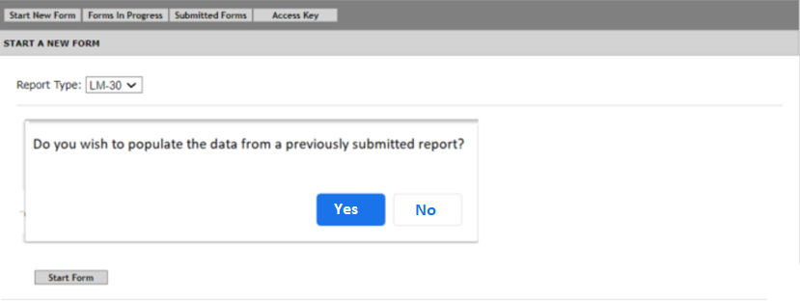
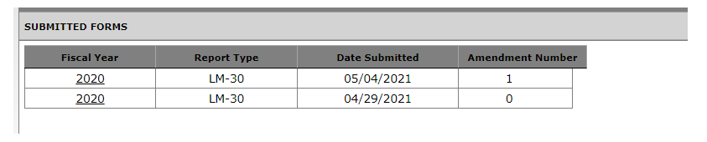
Pre-Populate Data From a Submitted LM-30 Report
When the filers return to submit a new special report and clicks the Start New button
The system will ask if the filer wants to pre-populate the data from a submitted report.
If the filer selects No the system will open a blank new form.
If the filer selects Yes, the system will list the submitted reports in the following format:
The filer will pick a report from the list.
The system will populate the data from the selected report on the form

Slide 33
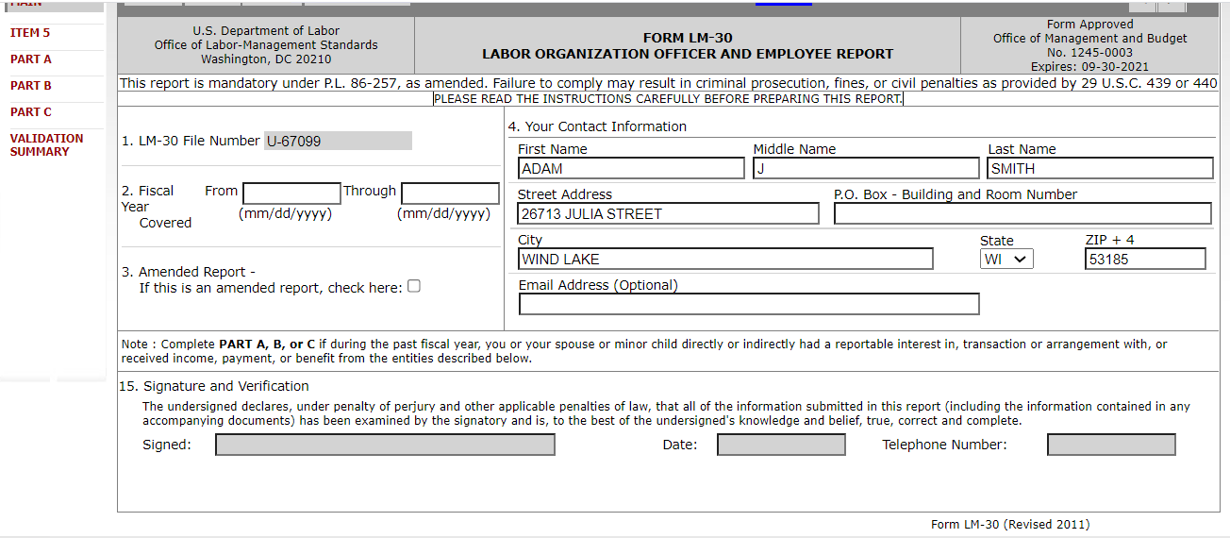
Returning LM-30 Filers Pre-populate data on the report
The data from the selected report, except Fiscal Year Covered, will be pre-populated on the form.
Fiscal Year Covered will be blank. The filer will have to enter the date.
The filer can modify everything except the File Number.

Slide 34
Pre-Populate Data From a Submitted LM-30 Report
During the validation, the system will check if there is an already submitted report for the same fiscal year.
The system will use the following fields to find the duplicate report:
Will check the Fiscal Year, Item 2.
If a duplicate report found, the following validation message will be displayed:
It appears that the Fiscal Year entered in this report has already been submitted. Are you submitting an amendment to the report submitted? With and Yes and No buttons
If the filer selects “Yes,” the system will convert the form in progress as an Amendment to the submitted report.
Selecting “No,” the system will consider the report as another one in the same fiscal year.
Amendment # 0 will be assigned for this report.

Slide 35
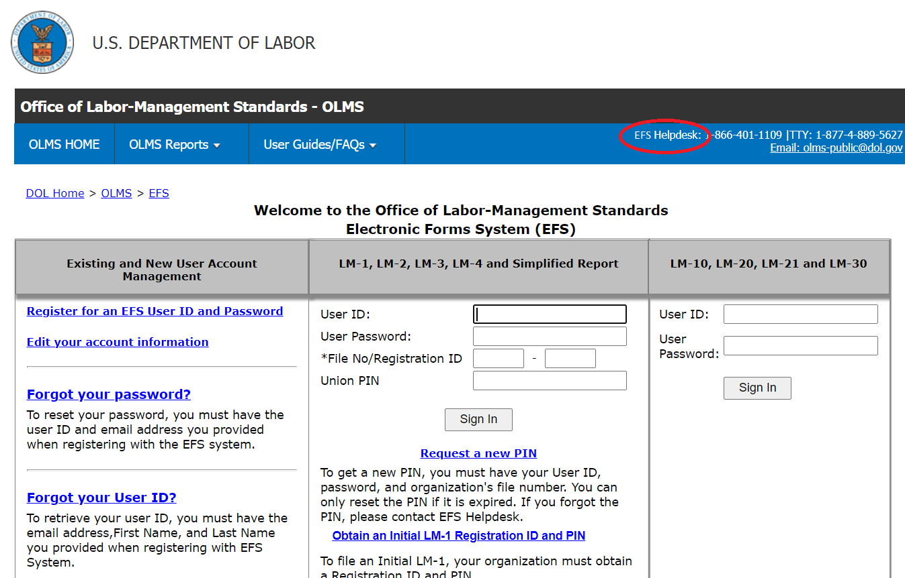
EFS Home Page update
On the EFS Homepage, the label for the helpdesk phone number should be renamed to EFS Helpdesk

